Slide 1

Project management
Viet-Trung Tran
trungtv.github.io
School of Information and Communication Technology

Slide 2
Outline

Slide 3
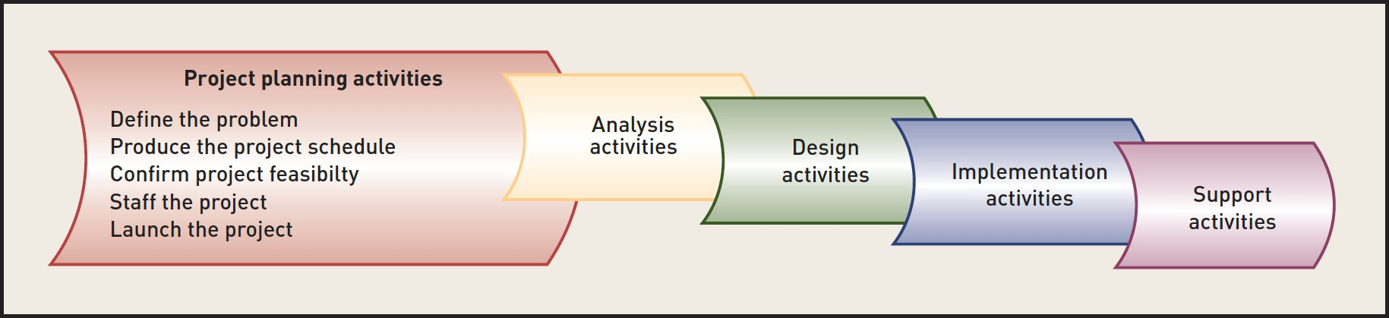
PROJECT PLANNING ACTIVITIES

Slide 4
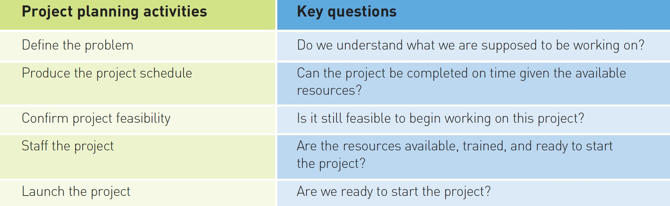
Key questions

Slide 5
Accurately defining the problem
System Vision Document
problem description
anticipated business benefits
system capabilities
How
Review the business needs
Develop a list of business benefits
Identify the new system’s ability to support the realization of these benefits

Slide 6
The vision document outline
Introduction
overview of the entire vision document. It includes the purpose, scope, definitions, acronyms, abbreviations, references, and an overview of the full document.
Positioning
Business opportunity: that is addressed by this project.
Problem statement: Summarize the problem that this project solves.
Stakeholder and user descriptions: identify and involve all stakeholders as part of the requirements-definition process
Product overview: Product perspective and Summary of capabilities
Product features
Constraints: note any design constraints, external constraints, such as operational or regulatory requirements, or other dependencies.
Quality ranges: define the quality ranges for performance, robustness, fault tolerance, usability, and similar characteristics that the feature set does not describe.
Precedence and priority
Other product requirements
Documentation Requirements

Slide 7
PRODUCING THE PROJECT SCHEDULE
A task is the smallest piece of work that is identified and scheduled
An activity is made up of a group of related tasks or other smaller activities. Activities are also identified, named, and scheduled
For example, in the design phase
Design the user interface (activity)
Design the customer entry form (task)
Design the order-entry form (task)
Design and integrate the database, and (activity)
Complete the application design (activity)

Slide 8
Development of a project schedule
One of the most difficult endeavors of project planning, yet it is one of the most important
Three main steps
Develop a work breakdown structure
Build a schedule using a Gantt chart
Develop resource requirements and the staffing plan

Slide 9
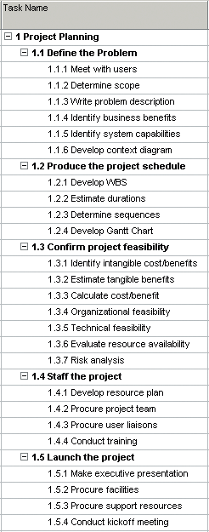
Developing a work breakdown structure
The first step in building a project schedule is to identify all of the activities and tasks that need to be scheduled
Work breakdown structure (WBS) is the hierarchy of phases, activities, and tasks of a project; one method to estimate and schedule the tasks of a project
Techniques
Top-down: Identifying major activities first and then listing internal tasks
Bottom-up: Listing all the tasks you can think of and organizing them later
Template: Using a standard template of tasks for projects that are fairly standard
Analogy: Finding a similar, or analogous, project that is finished and copying its tasks

Slide 10
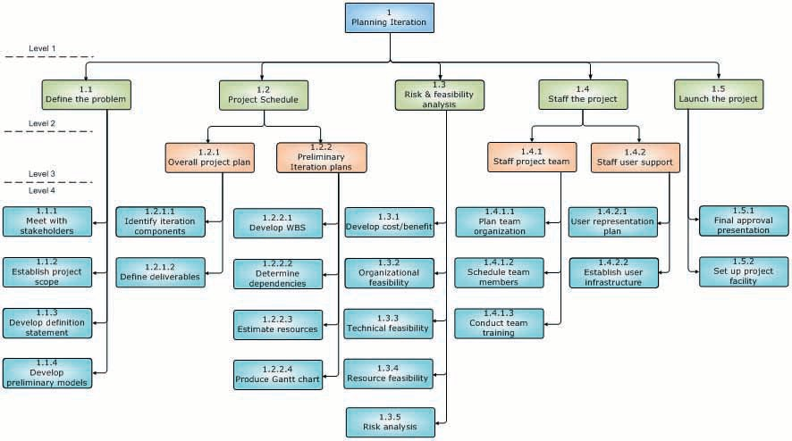
WSB template for planning iteration

Slide 11
How detailed should be the individual tasks?
There should be a way to recognize when the task is complete.
The definition of the task should be clear enough so that someone can estimate the amount of effort required to complete it.
As a general rule for software projects, the effort should take 2 to 10 working days.

Slide 12
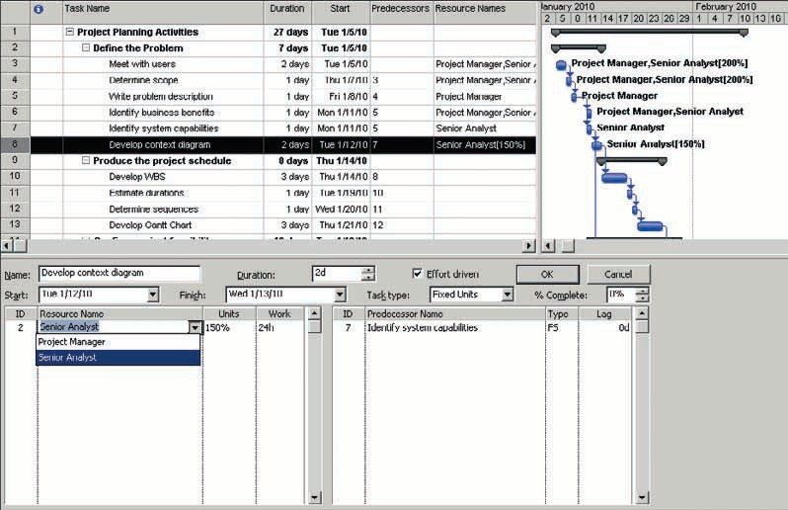
DEVELOPING THE SCHEDULE
A project schedule lists all project activities and tasks and the order in which they must be completed
must identify dependencies between the tasks on the WBS
estimate the effort that each task will require (employee effort, resource requirements and the staffing plan)

Slide 13
IDENTIFYING PROJECT RISKS AND CONFIRMING PROJECT FEASIBILITY
Project feasibility analysis is an activity that verifies whether a project can be started and successfully completed
Assess the risk to the project (risk management).
Determine the organizational and cultural feasibility.
Evaluate the technological feasibility.
Determine the schedule feasibility.
Assess the resource feasibility.
Determine the economic feasibility.

Slide 14
Risk management
Risk management is the project management area in which the team tries to identify potential trouble spots that could jeopardize the success of the project
a careful look at the overall feasibility and at the individual risks
done throughout the life of the project

Slide 15
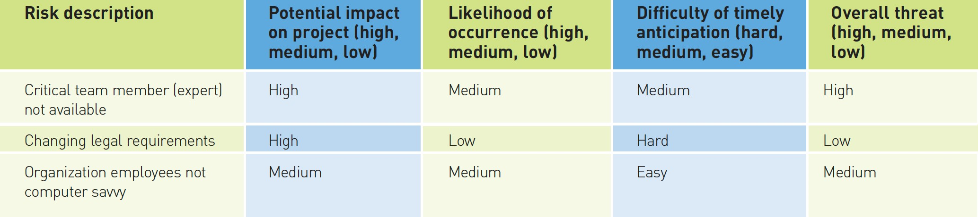
Simplified risk analysis
The best way to identify risks is simply to have a brainstorming session that include key project members and stakeholders

Slide 16
ORGANIZATIONAL AND CULTURAL FEASIBILITY
Each company has its own culture, and any new system must be accommodated within that culture
Common organizational and cultural issues
A current low level of computer competency
Substantial computer phobia
A perceived loss of control by staff or management
Potential shifting of political and organizational power due to the new system
Fear of change of job responsibilities
Fear of loss of employment due to increased automation
Reversal of long-standing work procedures
What items might prevent the effective use of the new system and the resulting loss of business benefits?

Slide 17
TECHNOLOGICAL FEASIBILITY
What are technological requirements of the new system?
What expertise is available?
How do we mitigate these technological risks?

Slide 18
SCHEDULE FEASIBILITY
Project scheduling is risky
Assumptions
Estimates
Unknowns
management-imposed constraints
organizational schedule (start of season/term)
How can we avoid them?

Slide 19
RESOURCE FEASIBILITY
The primary resource consists of team members
Quantity and quality (skills)
Team members may leave
Other resources
adequate computer resources
physical facilities
How do we avoid/minimize resource risks?

Slide 20
ECONOMIC FEASIBILITY
Economic feasibility consists of two tests
(1) Is the anticipated value of the benefits greater than projected costs of development? and
(2) Does the organization have adequate cash flow to fund the project during the development period?
Common sources of increased revenue, or lowered costs
new markets with new products, services, locations
increased market share
reduced staffing needs
decreased operating costs
decreased error rates
reduced inventory losses
collecting accounts more quickly

Slide 21
Cost-benefit Analysis
Tangible costs
personnel costs
equipment costs
supporting materials
converting to new system
Intangible costs
loss of customer good will
staff stress and distress
confusion with suppliers with new processes

Slide 22
Cost-benefit Analysis
Tangible benefits
Reduced cost
Increased efficiency
Intangible benefits
improved work practices
employee morale
ease of customer access to account details online
up to date product information online
increase loyalty of customers
Intangible benefits are not included in the cost/benefit analysis, but often they are the most important reason for initiating a project.

Slide 23
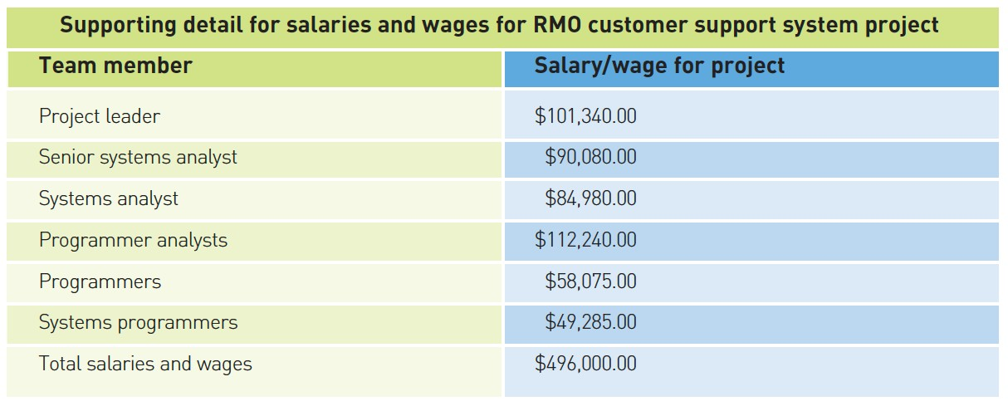
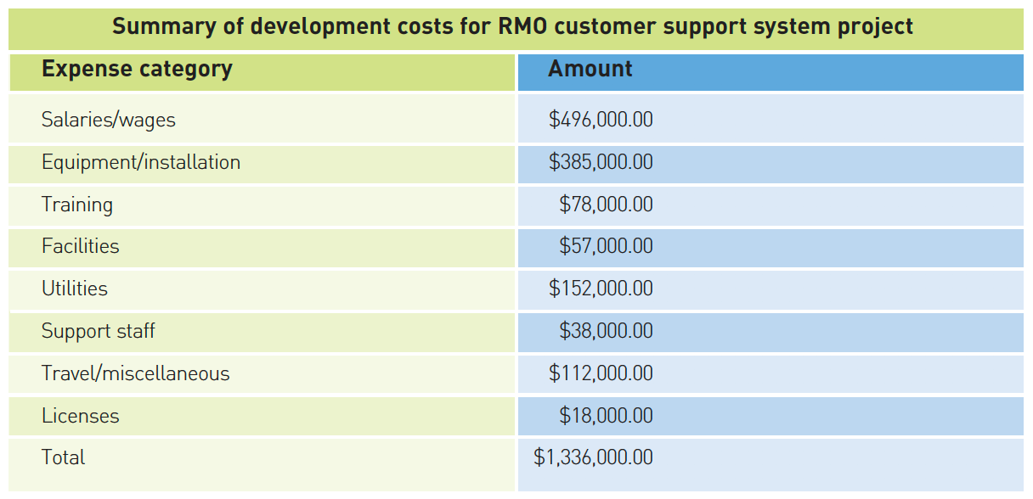

Slide 24
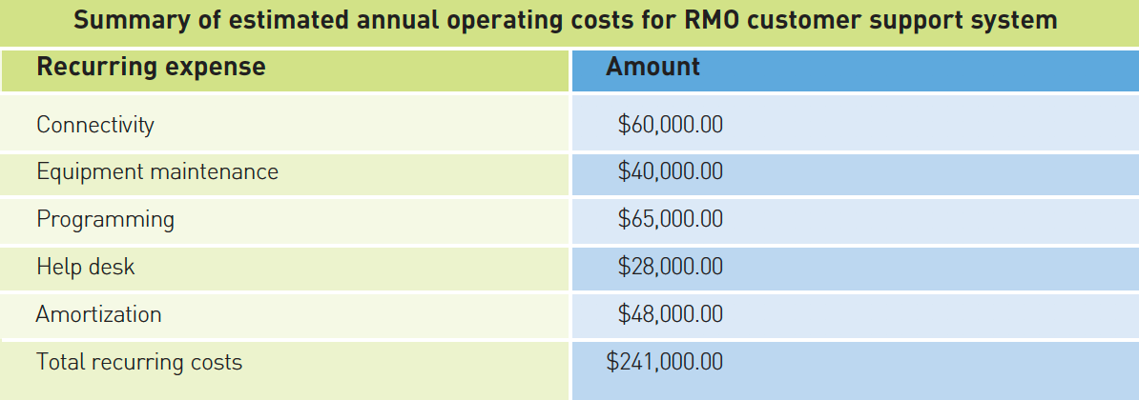
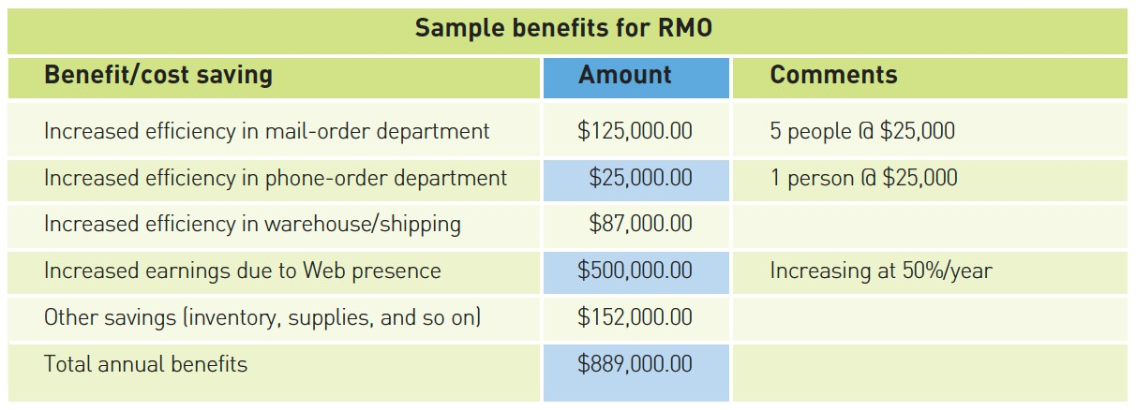

Slide 25
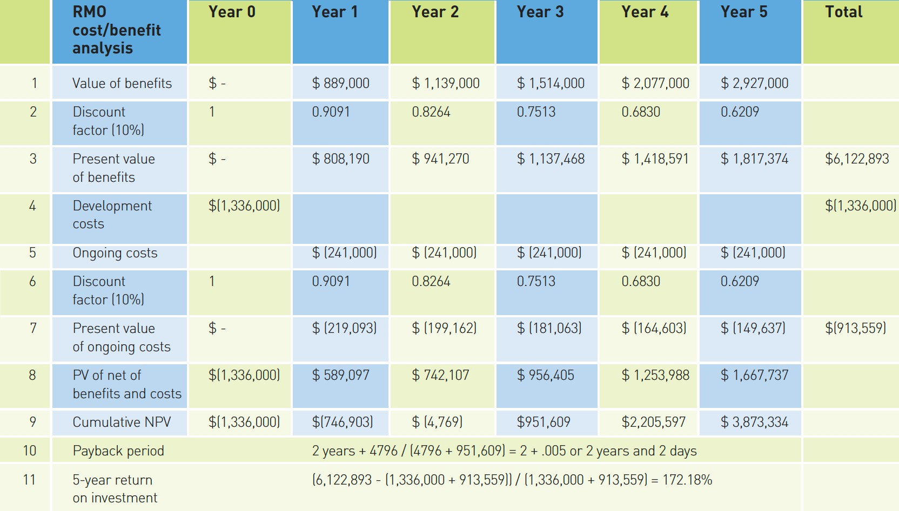
Net present value, payback period, and return on investment

Slide 26
Establish the Project Environment
Project manager must establish project parameters and the work environment
Recording and communicating—internal and external
Who, what, when, and how
Work environment
Workstations, software development tools (IDE), servers and repositories, office and meeting space, support staff
Process and procedures followed
Reporting and documentation, programming approach, testing, deliverables, code and version control
In other words, tailor and operationalize the methodology being used

Slide 27
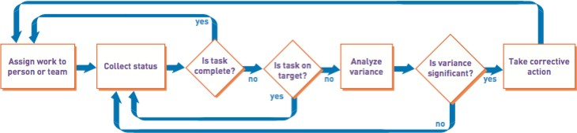
Evaluate Work Processes
Very important process for iterative projects
retrospective meeting
a meeting to determine what was successful, and what can be improved next iteration
done for each iteration
Monitor project progress and make corrections

Slide 28

Thank you for your attention! Q&A

